Slide 1




PHP Flow Control
Conditional Statements, Loops, Exit, Require
SoftUni Team
Technical Trainers
Software University
http://softuni.bg

Slide 2

Table of Contents
Conditional Statements
If and if-else
switch-case
Loops
While, Do…While, For, Foreach
Include and Require

Slide 3
Questions
sli.do #PHPFUND

Slide 4
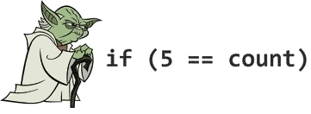
If and If-else
Implementing Conditional Logic

Slide 5
Conditional Statements: if-else
PHP implements the classical if / if-else statements:
$number = 5;
if ($number % 2 == 0) {
echo "This number is even.";
} else {
echo "This number is odd.";
}

Slide 6
Alternative If Syntax
PHP offers an alternative syntax for the if-statement:
<?php
$a == 5;
if ($a == 5):
echo "a equals 5";
echo "...";
elseif ($a == 6):
echo "a equals 6";
echo "!!!";
else:
echo "a is neither 5 nor 6";
endif;
?>

Slide 7
Problem: Odd / Even
Check if a number is odd or even or invalid
$num = 5;
$rem = fmod($num, 2);
if ($rem == 0) {
echo "even";
} else if ($rem == round($rem)) {
echo "odd";
} else {
echo "invalid";
}
5
odd
8
even
-3
odd
1.5
invalid
0
even

Slide 8

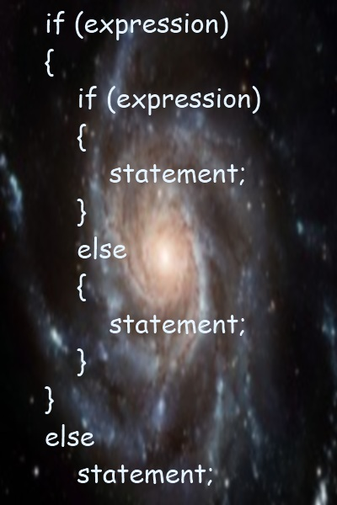
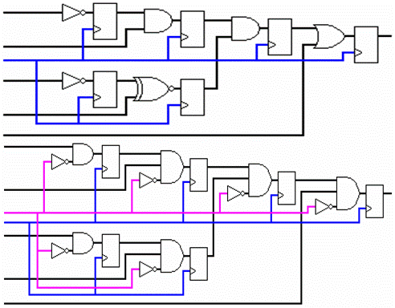
Practice: if and if-else
Live Exercises in Class (Lab)

Slide 9

switch-case
Making Several Comparisons at Once

Slide 10
The switch-case Statement
Selects for execution a statement from a list depending on the value of the switch expression
switch ($day) {
case 1: echo('Monday'); break;
case 2: echo('Tuesday'); break;
case 3: echo('Wednesday'); break;
case 4: echo('Thursday'); break;
case 5: echo('Friday'); break;
case 6: echo('Saturday'); break;
case 7: echo('Sunday'); break;
default: echo('Error!'); break;
}

Slide 11
Alternative Switch Syntax
PHP offers an alternative syntax for switch constructs:
$variable = 2;
switch ($variable):
case 1:
echo "<div>News</div>";
break;
case 2:
echo "<div>Forum</div>";
break;
endswitch;

Slide 12
Problem: Fruit or Vegetable
Print "fruit", "vegetable" or "unknown" depending on the input string
Fruits are: banana, apple, kiwi, cherry, lemon, grapes, peach
Vegetable are: tomato, cucumber, pepper, onion, garlic, parsley
All others are unknown
lemon
fruit
peach
fruit
onion
vegetable
pizza
unknown

Slide 13
Solution: Fruit or Vegetable
$word = $argv[1];
switch ($word) {
case 'banana':
case 'apple':
case 'kiwi':
case 'cherry':
case 'lemon':
case 'grapes':
case 'peach':
echo 'fruit';
break;
case 'tomato':
case 'cucumber':
case 'pepper':
case 'onion':
case 'parsley':
case 'garlic':
echo 'vegetable';
break;
default:
echo 'unknown';
}

Slide 14
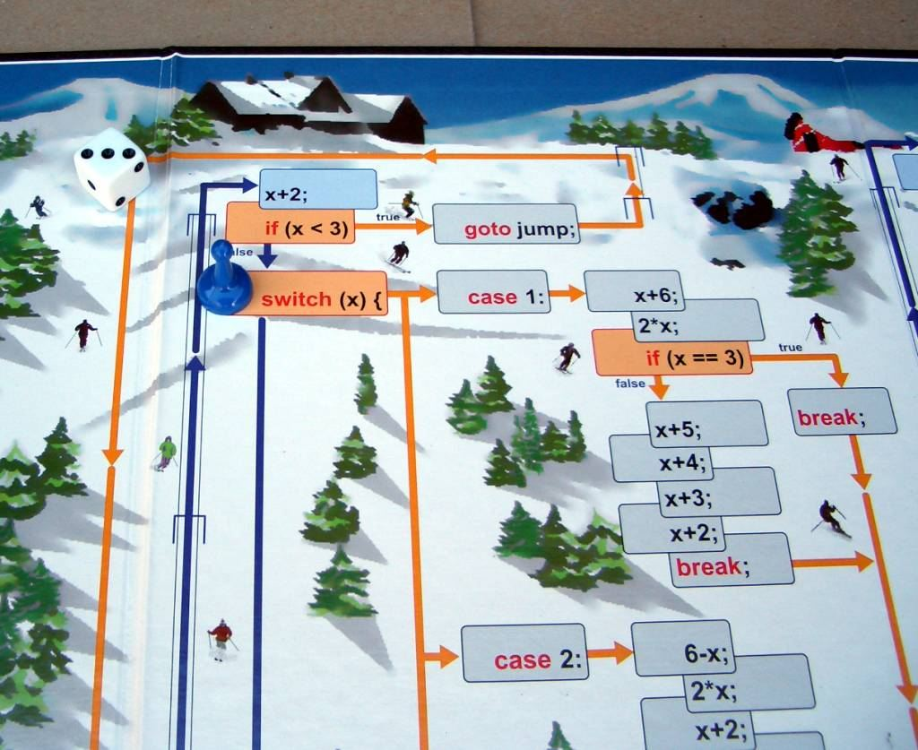
Practice: The switch-case Statement
Live Exercises in Class (Lab)

Slide 15
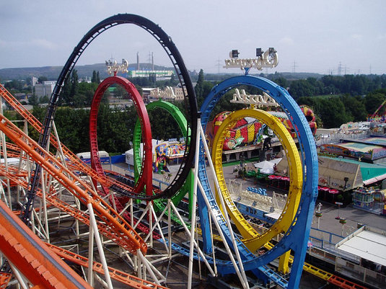
Loops

Slide 16
While Loop
While loops repeat a block while a certain condition is true:
while (expr) {
statement;
}
while (expr):
statement;
endwhile;
while ($count < 10) {
$count++;
echo $count;
}
while ($count < 10):
$count++;
echo $count;
endwhile;

Slide 17
While Loop – Example
Printing the numbers from 1 to 10:
$counter = 1;
while ($counter <= 10) {
echo "<p>$counter</p>";
$counter++;
}

Slide 18
While Loop – Alternative Syntax
While loops have alternative syntax, without { }
Printing the Unicode characters from &#0; to &#5000;
<?php
$charCode = 0;
while ($charCode <= 5000) : ?>
<div style="display: inline-block; width:80px">
<?= $charCode++ ?> -> &#<?= $charCode ?>;
</div>
<?php endwhile; ?>
<?= … ?> is like <?php echo … ?>

Slide 19
Do-While Loop
Do-while loops repeat a code block until some condition breaks
The loop body executes at least once
$i = 10;
do {
echo $i . " ";
$i--;
} while ($i > 0);
$i = -6;
do {
echo $i . " ";
$i--;
} while ($i > 0);
10 9 8 7 6 5 4 3 2 1
-6

Slide 20
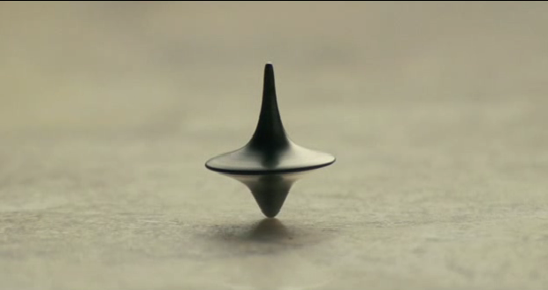
Practice: While Loops
Live Exercises in Class (Lab)

Slide 21
For Loops
The classical for-loop syntax is:
Example:
for (initialization; test; update) { statements; }
for ($i=0; $i < 10; $i++) { echo $i; }

Slide 22
For Loop – Examples
A simple for-loop to print the numbers 0...9:
for ($number = 0; $number < 10; $number++) {
echo $number . " ";
}
A simple for-loop to calculate n!:
$n = 5; $factorial = 1;
for ($i = 1; $i <= $n; $i++) {
$factorial *= $i;
}

Slide 23
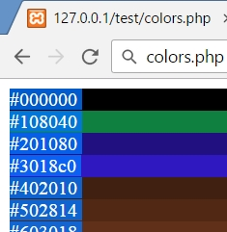
For-Loop – Alternative Syntax
Printing blocks of different colors:
<?php
for ($r=0, $g=0, $b=0; $r < 256; $r+=16, $g+=8, $b+=4) :
$color = "#" .
str_pad(dechex($r), 2, '0') .
str_pad(dechex($g), 2, '0') .
str_pad(dechex($b), 2, '0');
?>
<div style="width:400px;
background-color:<?= $color ?>">
<?= $color ?>
</div>
<?php endfor; ?>
dechex - Converts decimal to hexadecimal

Slide 24
Problem: Colorful Numbers 1 … n
Print all the numbers from 1 to n
Return a string holding HTML list <ul><li>…</li></ul>
Display the odd lines in blue, even lines in green
<ul>
<li><span style='color:blue'>1</span></li>
<li><span style='color:green'>2</span></li>
<li><span style='color:blue'>3</span></li>
…
</ul>

Slide 25
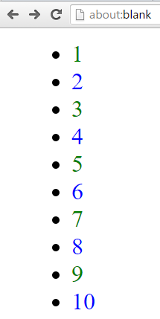
Solution: Colorful Numbers 1 … n
$n = 10;
$html = '<ul>\n';
for ($i = 1; $i <= $n; $i++) {
$color = 'blue';
if ($i % 2 != 0) {
$color = 'green';
}
$html += " <li><span style='color: $color'>$i</span></li>\n";
}
$html += '</ul>';

Slide 26
Practice: For Loops
Live Exercises in Class (Lab)

Slide 27
Foreach (1)
The foreach construct iterates over arrays and objects
Print all items of an array:
foreach (array_expression as $value) {
statements;
}
$colors = ["red", "green", "blue"];
foreach ($colors as $value) {
echo "$value <br>";
}

Slide 28
Foreach (2)
Iterate over the key-value pairs in associative array:
Print all items of an array and their keys:
foreach (array_expression as $key => $value) {
statements;
}
$colors = ["one" => "red", "two" => "green"];
foreach ($colors as $key => $value) {
echo "k-> $key v-> $value <br>";
}

Slide 29
Foreach – Alternative Syntax
Iterating over object properties:
<?php
$colors = (object)[];
$colors->red = "#F00";
$colors->slateblue = "#6A5ACD";
$colors->orange = "#FFA500";
foreach ($colors as $key => $value) : ?>
<p style="background-color:<?= $value ?>">
<?= $key ?> -> <?= $value ?>
</p>
<?php endforeach; ?>

Slide 30

Foreach Loops
Live Exercises in Class (Lab)

Slide 31
Continue
continue skips to the next loop iteration
Print all elements of array except 'second'
$stack = ['first', 'second', 'third']; foreach ($stack as $value) {
if ($value == 'second') {
continue;
}
echo $value.'<br>';
}

Slide 32
Break
break terminates the execution of the loop
Terminate if 'third' is in array
$stack = ['first', 'second', 'third'];
foreach ($stack as $value) {
if($value == 'third') {
break;
}
echo $value.'<br>';
}

Slide 33


Problem: Chessboard
Print a chessboard of size n. Examples:
<div class="chessboard">
<div>
<span class="black"></span>
<span class="white"></span>
</div>
<div>
<span class="white"></span>
<span class="black"></span>
</div>
<div>…</div>
</div>
n = 3
n = 4

Slide 34
Solution: Chessboard
$size = 5;
$html = '<div class="chessboard">';
for ($row = 0; $row < $size; $row++) {
$html .= ' <div>';
$color = ($row % 2 == 0) ? 'black' : 'white';
for ($col = 0; $col < $size; $col++) {
$html .= " <span class=\"$color\"></span>";
$color = ($color == 'white') ? 'black' : 'white';
}
$html .= ' </div>';
}
$html .= '</div>';
echo $html;

Slide 35

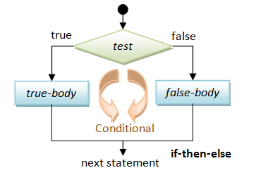
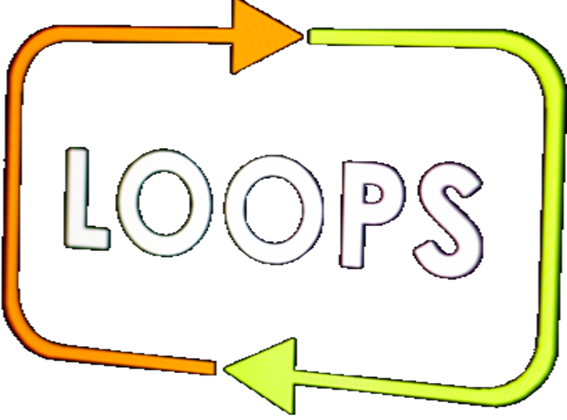
Practice: Operators, Expressions, Conditional Statements, Loops
Exercises in Class (Lab)

Slide 36
Exit
The exit statement ends the PHP script execution immediately
Used for fatal errors, e.g. missing file / resource / database
If the statement is a number, that value will be used as the exit status and not printed
If it is a string, the value is printed before the process terminates
$filename = '/path/to/data-file';
$file = fopen($filename, 'r')
|| exit("Unable to open file: $filename");

Slide 37
Die
The function die() is an alias for the exit statement:
The message is required
The die() function prints a message and exits the current script:
die(message);
$db = mysql_connect("localhost", $username, $password);
if ( ! $db) {
die("Could not connect to database");
}

Slide 38

Exit
Live Demo

Slide 39

Include and Require
Including a Script from Another Script

Slide 40
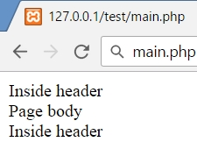

Include and Require
include and require load and evaluate a file holding PHP code
Difference between include and require:
If file is not found include produces a warning
require produces a fatal error
main.php
header.php
require "header.php";
echo "page body<br>";
include "footer.php";
echo….
footer.php
echo….

Slide 41
include_once and require_once
With include and require you can include one file many times and each time it is evaluated
With include_once and require_once if file is already included, nothing happens
header.php
main.php
function test();
require "header.php";
echo "Page body<br>";
include "header.php";
footer.php
function test();
Fatal error: Cannot redeclare test()…

Slide 42
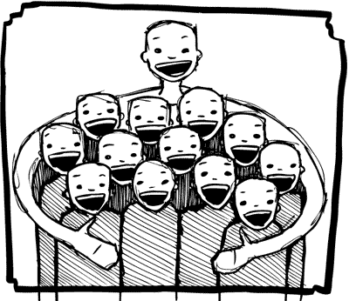
Include and Require
Live Demo

Slide 43

Summary
If-else statements are as in C#, Java and C++
Alternative syntax: if-elseif-endif
Switch-case statement are similar to Java / C#
PHP supports the classical loop statements
While, do…while, for, foreach
PHP code may define and invoke functions
Functions may take parameters and return value
Including PHP code in another PHP code
include / include_once / require / require_once

Slide 44








PHP Flow Control
https://softuni.bg/courses/php-basics/

Slide 45
License
This course (slides, examples, demos, videos, homework, etc.) is licensed under the "Creative Commons Attribution-NonCommercial-ShareAlike 4.0 International" license
Attribution: this work may contain portions from
"PHP Manual" by The PHP Group under CC-BY license
"PHP and MySQL Web Development" course by Telerik Academy under CC-BY-NC-SA license

Slide 46




Free Trainings @ Software University
Software University Foundation – softuni.org
Software University – High-Quality Education, Profession and Job for Software Developers
softuni.bg
Software University @ Facebook
facebook.com/SoftwareUniversity
Software University @ YouTube
youtube.com/SoftwareUniversity
Software University Forums – forum.softuni.bg

